Slide 1
Drawing and Coordinate Systems

Slide 2
The viewport refers to the region of the screen where the rendered graphics are displayed. It's essentially the area of the window or screen where the graphics are visible to the user. Viewport settings can include parameters like position, size, and aspect ratio, determining how the rendered scene is displayed on the screen.

Slide 3
Orthographic 2D projection is a way of showing 2D graphics on a screen without making faraway objects look smaller or closer ones larger. It keeps everything the same size no matter how far away it is. It's like looking at a flat picture where everything stays the same size, regardless of how far away it is in the scene.

Slide 4
Coordinate Systems
World Coordinate system
World window
Screen Coordinate system
Viewport
Window to viewport mapping
Notes:
MODEL/WORLD WINDOW-TO-VIEWPORT COORDINATE TRANSFORMATION
A world-coordinate area selected for display is called a window.
An area on a display device to which a window is mapped is called a viewport.
The window defines what is to be viewed; the viewport defines where it is to be displayed.

Slide 5
MODEL/WORLD WINDOW-TO-VIEWPORT COORDINATE TRANSFORMATION
A world-coordinate area selected for display is called a window.
An area on a display device to which a window is mapped is called a viewport.
The window defines what is to be viewed; the viewport defines where it is to be displayed.

Slide 6
Screen Coordinate System
2D Regular Cartesian Grid
Origin (0,0) at lower left
corner (OpenGL convention)
Horizontal axis – x
Vertical axis – y
Pixels are defined at the grid intersections
This coordinate system is defined relative to the display window origin
(OpenGL: the lower left corner of the window)
(0,0)
y
x
(2,2)

Slide 7
World Coordinate System
10 feet
20 feet

Slide 8
Define a world window

Slide 9
World Window
World window – a rectangular region in the world that is to be displayed
W_T
Define by
W_L, W_R, W_B, W_T
W_B
Use OpenGL command:
gluOrtho2D(left, right, bottom,
top)
W_L
W_R

Slide 10
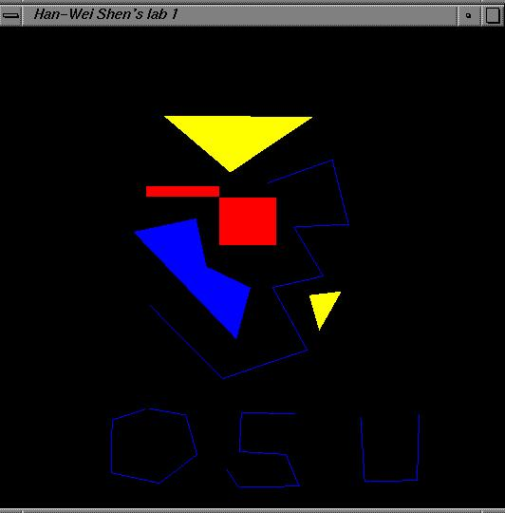
Viewport
The rectangular region in the screen for displaying the graphical objects defined in the world window
Defined in the screen coordinate system
glViewport(int left, int bottom, int (right-left), int (top-bottom));
call this function before drawing (calling glBegin() and glEnd() )
V_T
V_B
V_L
V_R

Slide 12
To draw in world coordinate system
Three tasks need to be done
Define a rectangular world window
(call an OpenGL function)
Define a viewport (call an OpenGL function)
Perform window to viewport mapping

Slide 13
Window to viewport mapping
The objects in the world window will then be drawn onto the viewport
(x,y)
viewport
World window
(Sx, Sy)
Notes:
Panning
Moving the window around the world
Zooming
Reducing/increasing the window size
Tiling
W-to-V in loop, adjacent viewports
Flipping drawings

Slide 14
Window to viewport mapping
How to calculate (sx, sy) from (x,y)?
(x,y)
(Sx, Sy)

Slide 15
Window to viewport mapping
Before calling gluOrtho2D(), you need to have the following two lines of code –
glMatrixMode(GL_PROJECTION);
glLoadIdentity();
Things that are given:
The world window (W_L, W_R, W_B, W_T) (l,r,b,t)
The viewport (V_L, V_R, V_B, V_T) (l,r,b,t)
A point (x,y) in the world coordinate system
Calculate the corresponding point (sx, sy) in the screen coordinate system

Slide 16
Window to viewport mapping
Basic principle: the mapping should be proportional
(x,y)
(sx,sy)
(x – W_L) / (W_R – W_L) = (sx – V_L) / (V_R – V_L)
(y - W_B) / (W_T – W_B) = (sy – V_B) / (V_T – V_B)

Slide 17
Window to viewport mapping
(x,y)
(sx,sy)
(x – W_L) / (W_R – W_L) = (sx – V_L) / (V_R – V_L)
(y - W_B) / (W_T – W_B) = (sy – V_B) / (V_T – V_B)
sx = x * (V_R-V_L)/(W_R-W_L) - W_L * (V_R – V_L)/(W_R-W_L) + V_L
sy = y * (V_T-V_B)/(W_T-W_B) – W_B * (V_T-V_B)/(W_T-W_B) + V_B

Slide 18
Example
What is (Sx,Sy) for point (3.4,1.2) in world coordinates if:
Hence, point (3.4,1.2) in world = point (332,176) on screen

Slide 19
Example
What is (Sx,Sy) for point (2,3) in world coordinates if:
Hence, point (2,3) in world = point (?,?) on screen
sx = x * (V_R-V_L)/(W_R-W_L) - W_L * (V_R – V_L)/(W_R-W_L) + V_L
sy = y * (V_T-V_B)/(W_T-W_B) – W_B * (V_T-V_B)/(W_T-W_B) + V_B

Slide 20
Example
What is (Sx,Sy) for point (4,5) in world coordinates if:
Hence, point (4,5) in world = point (?,?) on screen
sx = x * (V_R-V_L)/(W_R-W_L) - W_L * (V_R – V_L)/(W_R-W_L) + V_L
sy = y * (V_T-V_B)/(W_T-W_B) – W_B * (V_T-V_B)/(W_T-W_B) + V_B

Slide 21
World window set up
Find the world coordinates extent that will cover the entire scene
max Y
min Y
min X
max X

Slide 22
Zoom into the picture
Shrink your world window – call gluOrtho2D() with a new range
Viewport

Slide 23
Non-distorted viewport setup
Distortion happens when …
World window and display window have different aspect ratios
Aspect ratio is R = W / H
CASE 1: R > W / H
CASE 2: R < W / H

Slide 24
Compare aspect ratios
H
W
World window
Aspect Ratio = R
Display window
Aspect Ratio = W / H
R > W / H

Slide 25
CASE 1: R > W / H
glViewport(0, 0, W, W/R)
H
R
W/R
World window
Aspect Ratio = R
W
Display window
Aspect Ratio = W / H
R > W / H

Slide 26
Case 2: R < W / H
H
W
World window
Aspect Ratio = R
Display window
Aspect Ratio = W / H
R < W / H

Slide 27
Match Aspect Ratios
?
H
W
World window
Aspect Ratio = R
Display window
Aspect Ratio = W / H
R < W / H

Slide 28
Match aspect ratios
glViewport(0, 0, H*R, H)
H * R
H
W
World window
Aspect Ratio = R
Display window
Aspect Ratio = W / H
R < W / H

Slide 29
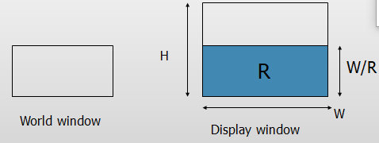
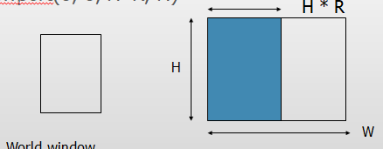
CASE 1: R > W / H glViewport(0, 0, W, W/R) CASE 2: R < W / H glViewport(0, 0, H*R, H)

Slide 30
Put it all together
DrawQuad()
{
glViewport(0,0,300,200);
glMatrixMode(GL_PROJECTION);
glLoadIdentity();
gluOrtho2D(-1,1,-1,1);
glBegin(GL_QUADS);
glColor3f(1,1,0);
glVertex2f(-0.5,-0.5);
glVertex2f(+0.5,-0.5);
glVertex2f(+0.5,+0.5);
glVertex2f(-0.5,+0.5);
glEnd();
}
(300,200)
(0,0)
viewport
How big is the quad?

Slide 31


Lets change the ORTHO 2d
Changing the orthographic projection from –1 to +1 to –2 to +2 makes the square appear smaller
the visible coordinate system becomes larger, fitting more objects into the same screen space.
Before
After

Slide 32
Well, this works too …
main()
{
…
glBegin(GL_QUADS);
glColor3f(1,1,0);
glVertex2f(-0.5,-0.5);
glVertex2f(+0.5,0);
glVertex2f(+0.5,+0.5);
glVertex2f(-0.5,+0.5);
glEnd();
}
OpenGL Default:
glViewport: as large as
you display window
gluOrtho2D:
gluOrtho2D(-1,1,-1,1);
OpenGL Default:
glViewport: as large as
you display window
gluOrtho2D:
gluOrtho2D(-1,1,-1,1);

Slide 33
Compare aspect ratios
H
World window
W
Display window
R > W / H

Slide 34
Task3:
What is (Sx,Sy) for point (3.4,1.2) in world coordinates if:
W=(0,4,0,2)
V=(60,380,80,240)

